Slide 1

Developmentally-appropriate Practice:​ Joyful Learning & Instruction Across P–3 Classrooms​
Katherine Beauchat Ed.D. katherine.beauchat@mga.edu​

Slide 2

Preschool (1 of 3)
Preschool children engaging in daily meaningful writing experiences. ​
Here children are drawing and labeling pictures based on their “Signs of Spring” outdoor walk and read alouds.​
Engaged writers!​

Slide 3

Preschool (2 of 3)
Preschool teacher conducting a daily interactive read aloud, reading with fluency, expression and enthusiasm, and pausing to ask students open-ended questions throughout the read aloud. Students love to share their thoughts!​

Slide 4

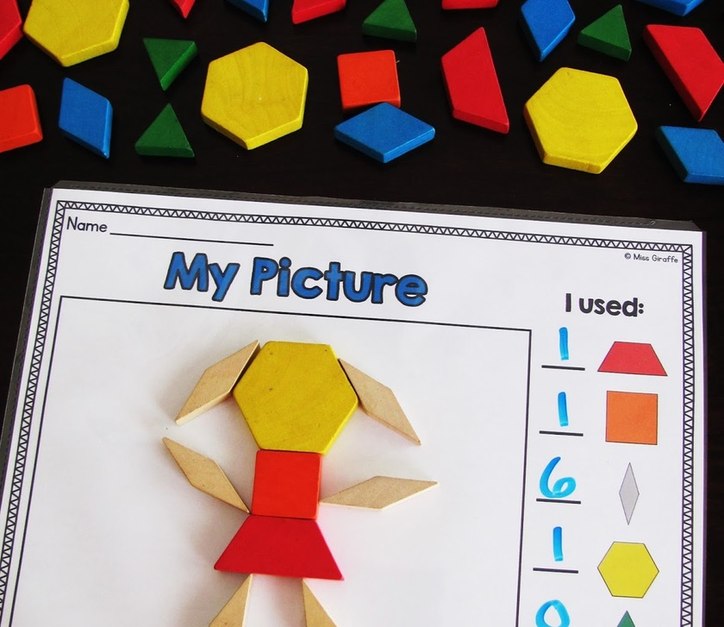
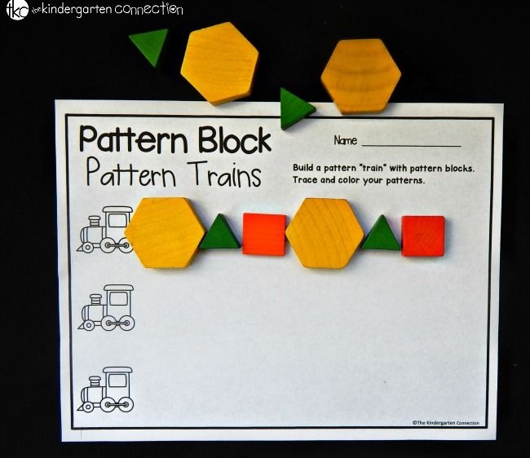
Preschool (3 of 3)
Preschool students engaged in making various shape patterns.​
Using foundational math skills, they are learning to recognize predictable regularities, make logical connections, and understand relationships between shapes, which are crucial for future math concepts.
This math activity fosters critical thinking and visual perception abilities through playful learning.​

Slide 5
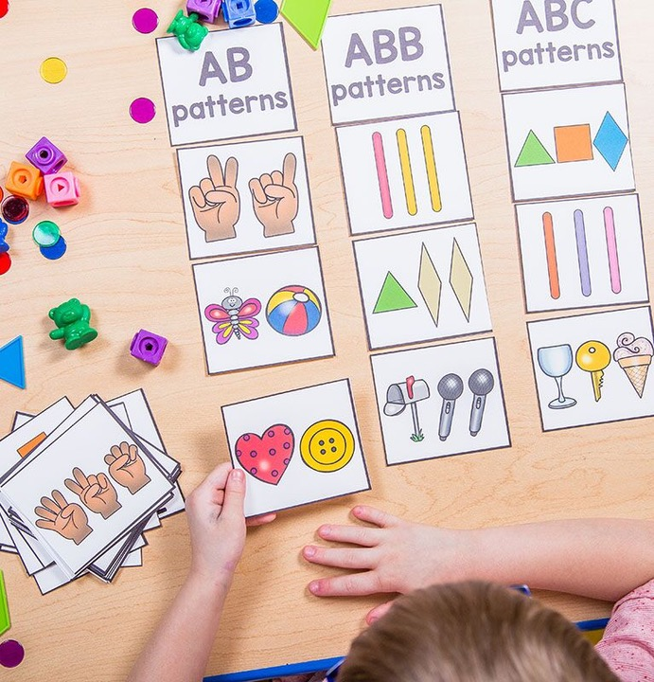
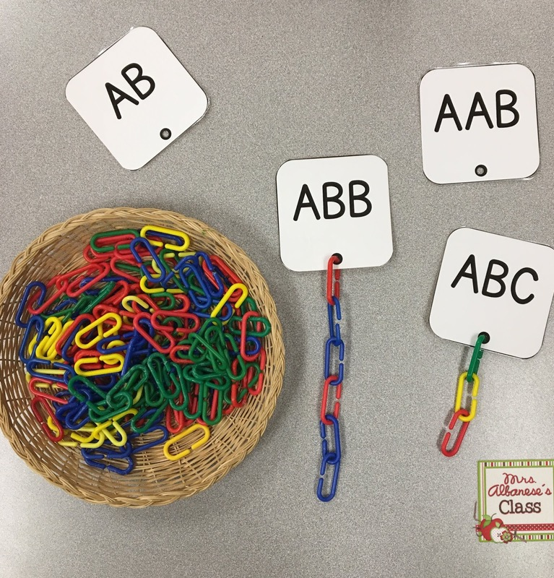
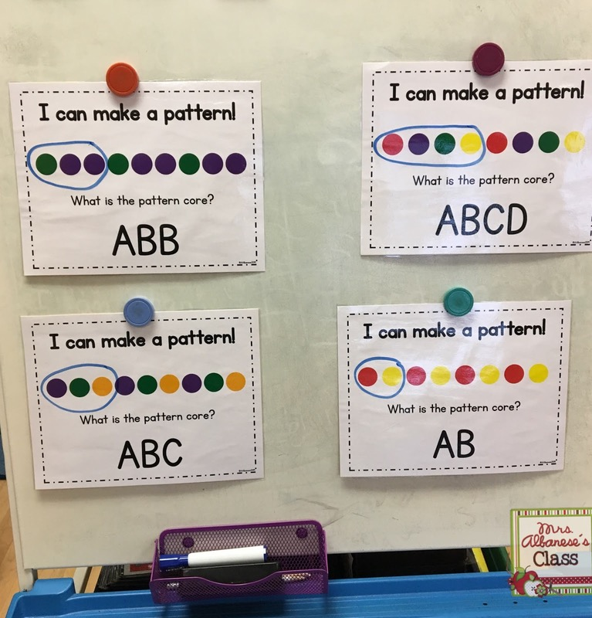
Kindergarten (1 of 3)
Kindergarten children engaged in pattern play at math center.​
Building on foundational math skills, children create patterns using different colored blocks or beads, identifying repeating sequences and extending the pattern.​

Slide 6
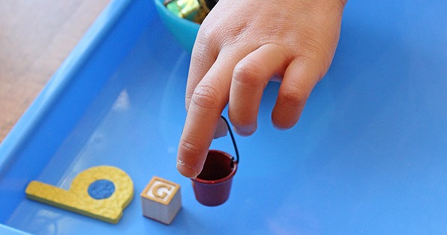
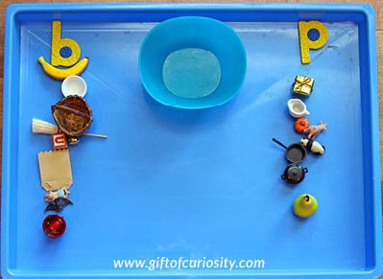
Kindergarten (2 of 3)
Kindergarten children in daily small group with the teacher working on sorting objects by initial sounds. ​
Using multisensory instruction, this teacher is supporting young student phonological awareness, a critical skill for reading and spelling. ​

Slide 7
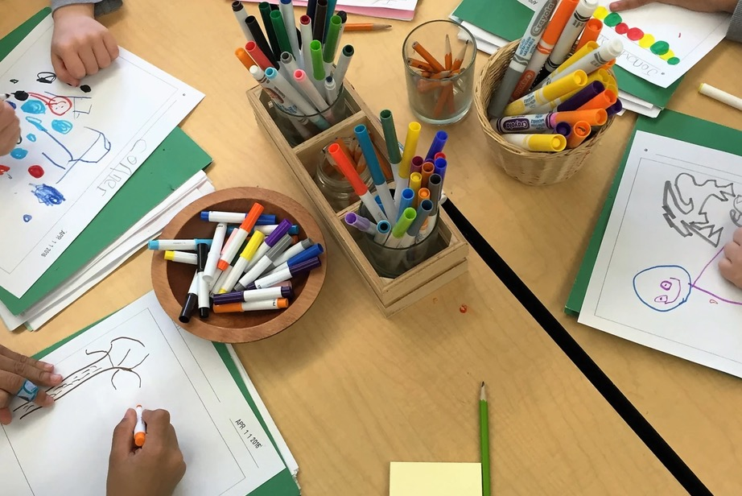
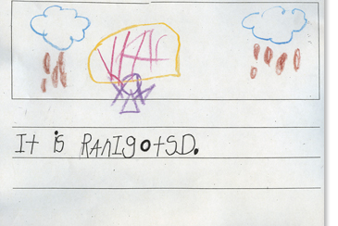
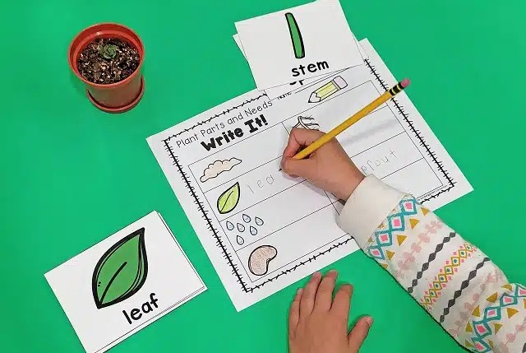
Kindergarten (3 of 3)
Kindergartners are often enthusiastic writers and they will weave writing activities into their play and content area instruction, like math and science.
Provide these budding writers with experiences that give them something to write about. Invented spelling is normal at this age, as children are translating the sounds of spoken words into writing.

Slide 8
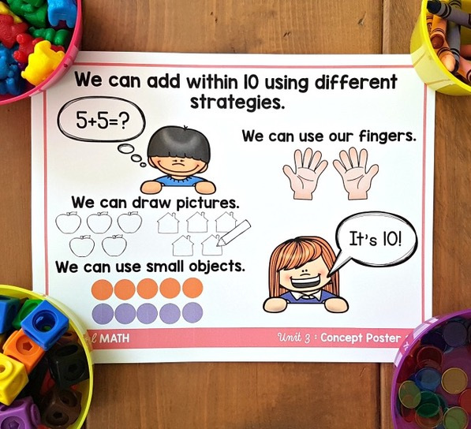
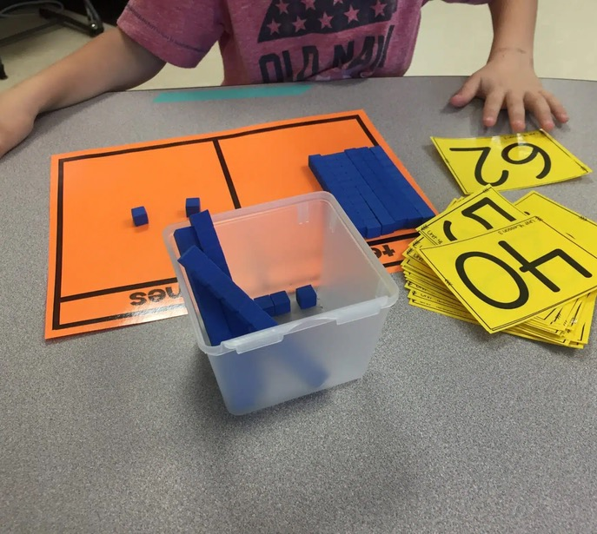
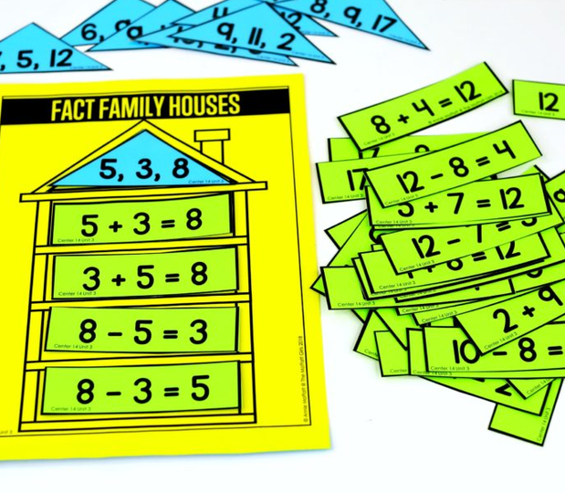
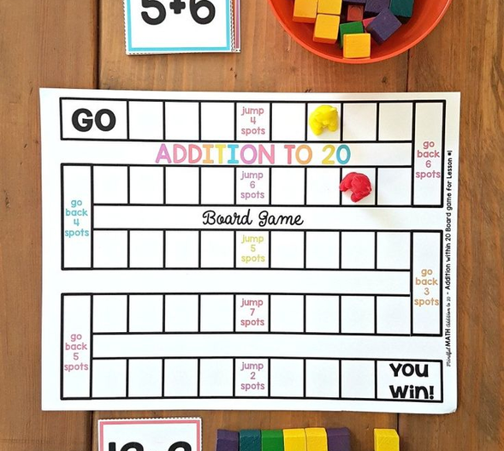
First Grade (1 of 2)
Using multisensory instruction and manipulatives, First Grade children apply and reinforce addition and subtraction strategies in Math Center.
First graders learn to add and subtract numbers up to 20, and solve word problems using drawings, objects, and equations.

Slide 9

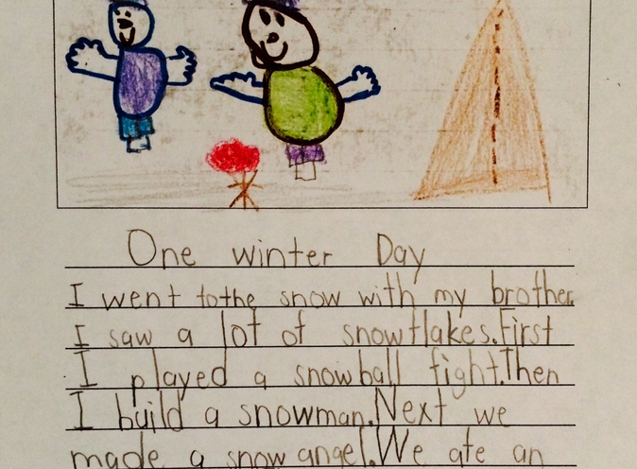
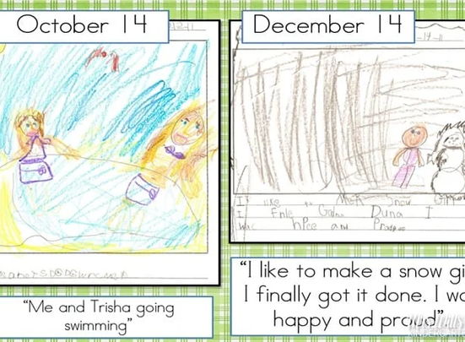
First Grade (2 of 2)
First graders write many times a day to express their ideas and interests — they are writing with a purpose, through, stories, letters, and lists. They can print clearly and leave spaces between words.
Children in first grade are able to write simple but complete sentences, and they are beginning to understand when to use capital letters, commas, and periods.

Slide 10
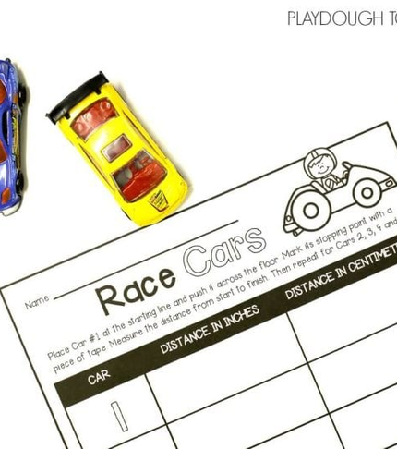
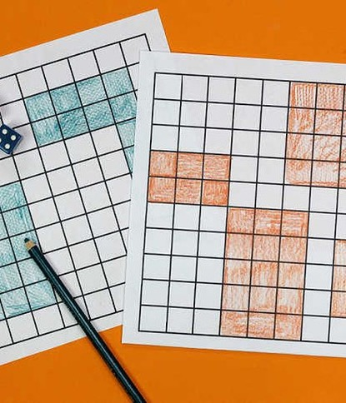
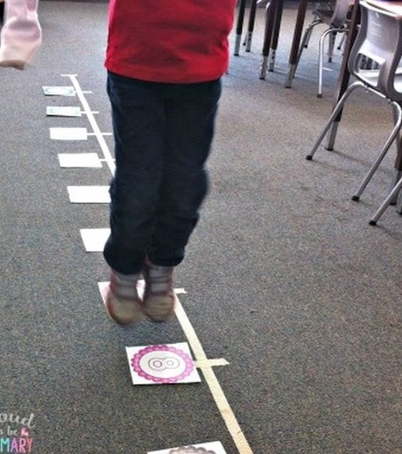
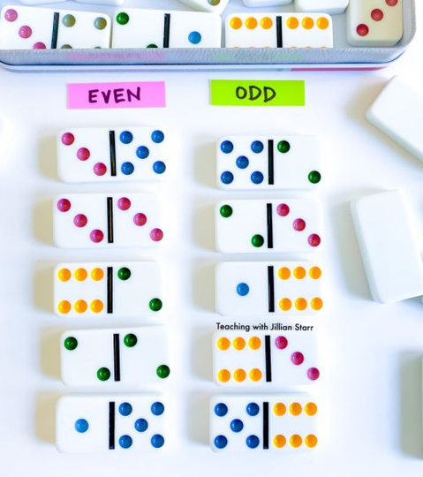
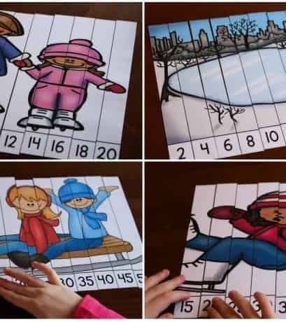
Second Grade (1 of 2)
Second grade students continue with more sophisticated approaches to addition and subtraction and begin understanding the patterns leading to multiplication. Geometric learning extends a student's understanding of shapes and their parts.
Second graders learn to read and write numbers to 1,000. They practice skip counting by 5s, 10s, and 100s as they notice patterns among numbers.
Rs.

Slide 11
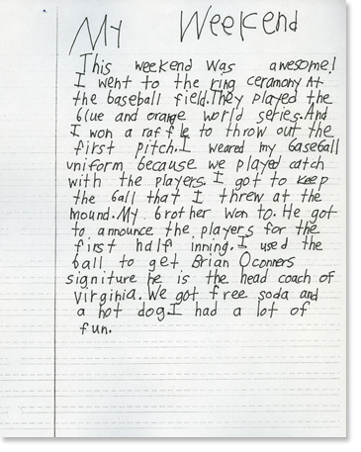

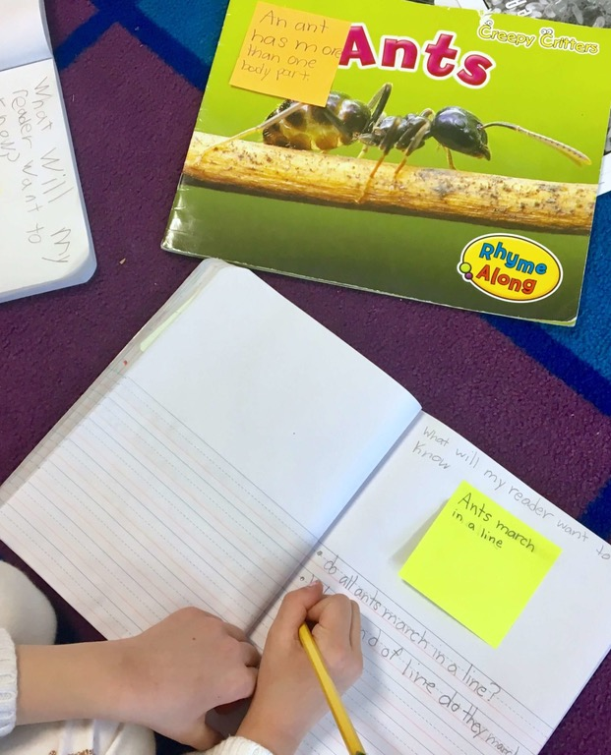
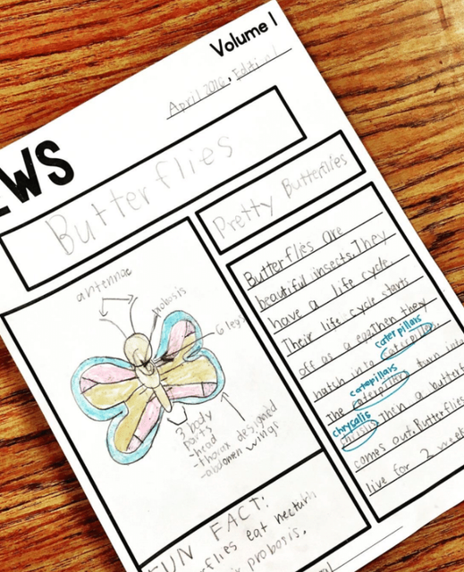
Second Grade (2 of 2)
Second graders are polishing a wide range of basic writing skills, including writing legibly, using capitalization and punctuation correctly (most of the time!), and moving from invented spelling to more accurate spelling.
For most, handwriting becomes automatic, so they can concentrate more on the content of their writing rather than on the mechanics.

Slide 12

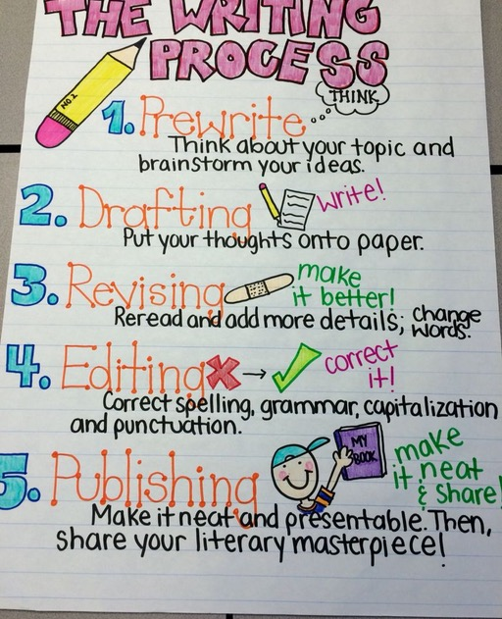
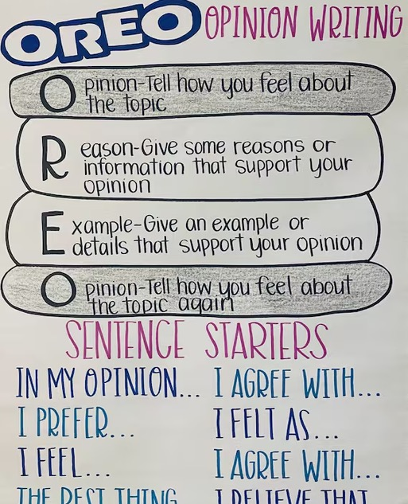
Third Grade (1 of 2)
During third grade, children are really flexing their “idea” muscles and learning to express those ideas in more sophisticated ways. Sentences are getting longer and more complex.
Grammar improves; for example, you’ll see appropriate punctuation, contractions, and correct subject-verb agreement.

Slide 13
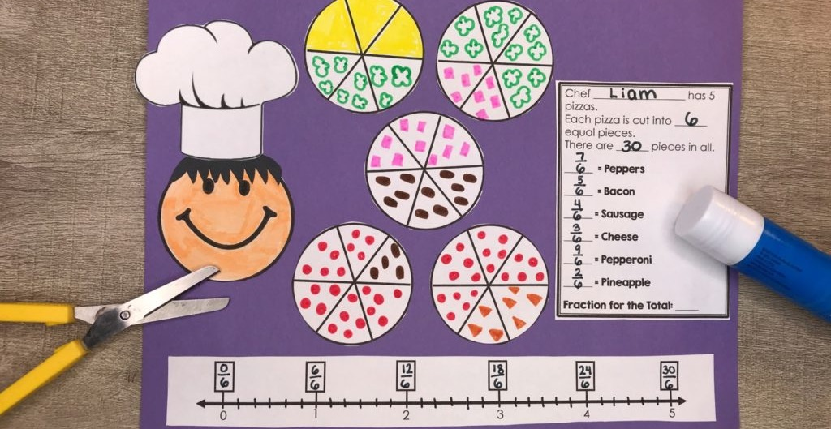
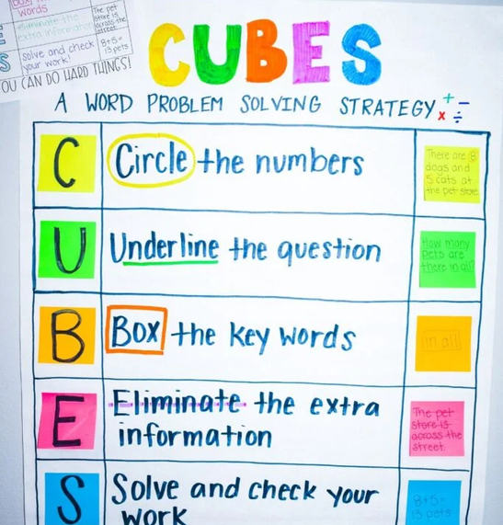
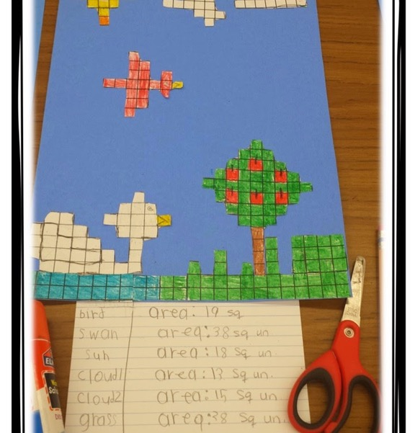
Third Grade (2 of 2)
Third grade is a big year for learning math!
Building on previous math skills and strategies, students learn about multiplication and division, dive into fractions, and even start calculating areas and perimeters.

Slide 14

Developmentally Appropriate Practices
What do these practices have in common?
They are all examples of Developmentally-Appropriate Practices (DAP) across P–3!

Slide 15

What is DAP? (1 of 5)
Developmentally Appropriate Practice (DAP) is an educational framework that promotes each child’s optimal development and learning through a strengths-based, play-based approach.
It involves recognizing and building upon the unique assets of each child, considering their individuality, family background, and community culture.

Slide 16

What is DAP? (2 of 5)
Each and every child, birth through age 8, has the right to equitable learning opportunities—in centers, family childcare homes, or schools—that fully support their optimal development and learning across all domains and content areas.

Slide 17
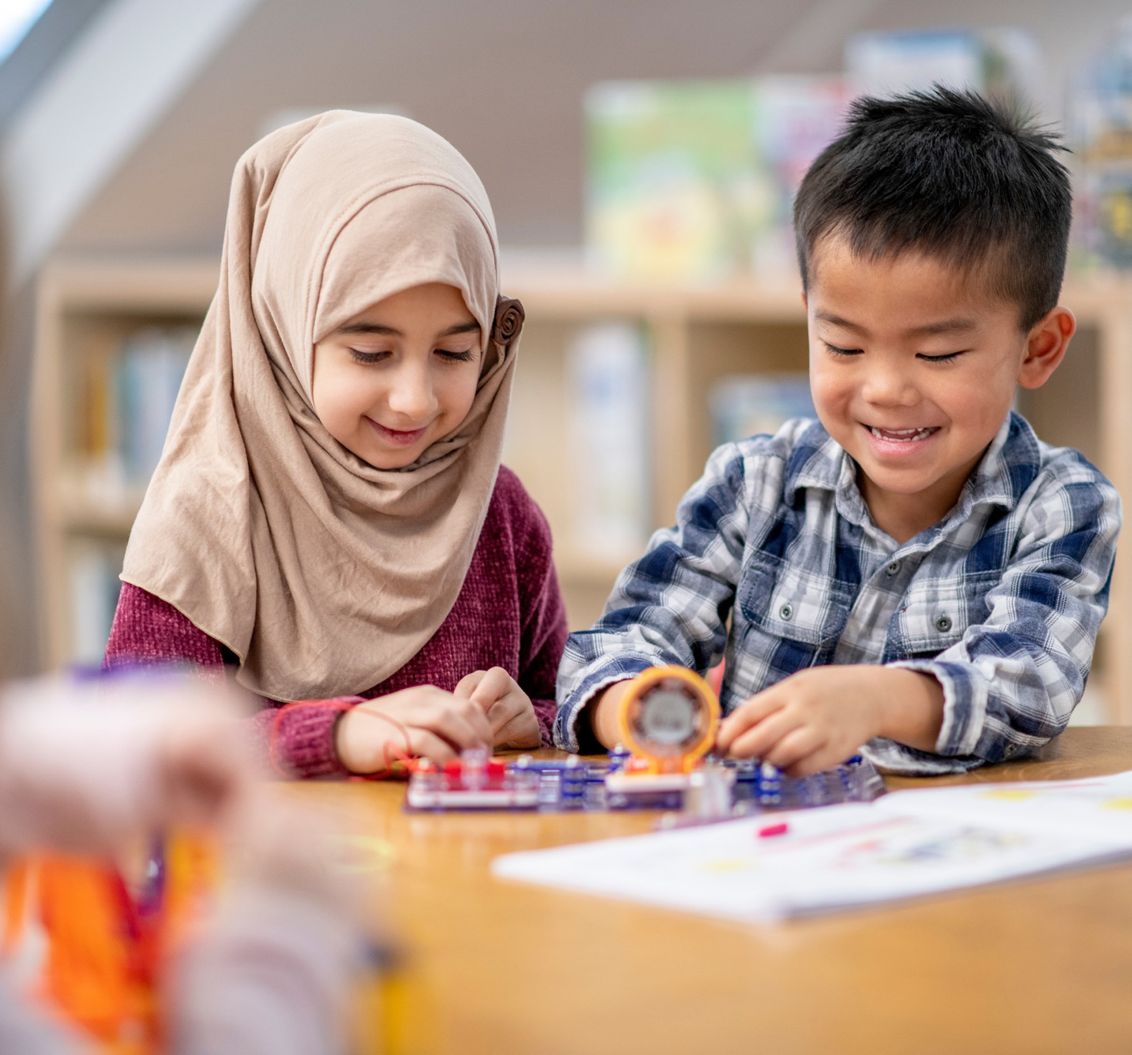
What is DAP? (3 of 5)
Children are born eager to learn; they take delight exploring their world and making connections.
The degree to which early learning programs support children’s delight and wonder in learning reflects the quality of that setting.

Slide 18

What is DAP? (4 of 5)
Young children learn best when they have positive and caring relationships with adults and other children; when they receive carefully planned, intentional guidance and assistance.

Slide 19

What is DAP? (5 of 5)
DAP emphasizes active, joyful engagement in learning, ensuring that educational practices are culturally, linguistically, and ability appropriate.

Slide 20

DAP in Preschool Ages 3–5
Preschool children learn best when they have positive and caring relationships with adults and other children; when they receive carefully planned, intentional guidance and assistance; and when they can safely encounter and explore many interesting things in their environment.

Slide 21

DAP in Kindergarten Ages 5–6:
Kindergarten is a time of change, challenge, and opportunity. Because of the great individual variation among kindergarteners and the wide age range of kindergarten children teachers must be responsive to developmental, individual, and cultural variations.
.
Five- and 6-year-olds make great intellectual leaps. They go through a major shift, allowing them to develop more personal responsibility, self-direction, and logical thinking.

Slide 22
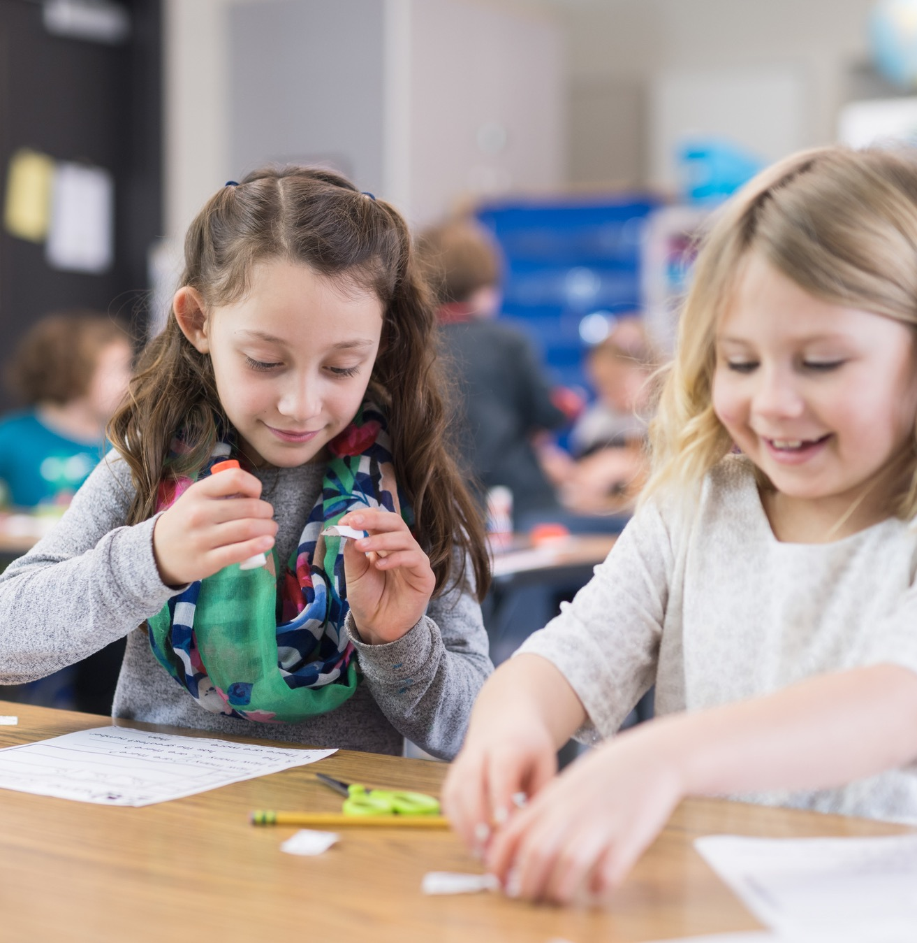
DAP in the Early Primary Grades Ages 6–8:
Best practices in first, second, and third grades involve balancing children’s need for focused instruction with their need to build on what they already know.
Primary grade children benefit from concrete hands-on experiences. They need to see and make connections, especially across subjects.

Slide 23

10 Effective DAP Strategies
An effective teacher chooses a strategy to fit a particular situation. Consider what the children already know, what they can do, and the learning goals for each situation. It’s important to be flexible and observant!

Slide 24


1. Acknowledge
What children do or say.
Let children know what we have noticed, through comments, or by sitting nearby and observing.
“Thanks for your help, Kevin! You found another way to show 5.”

Slide 25
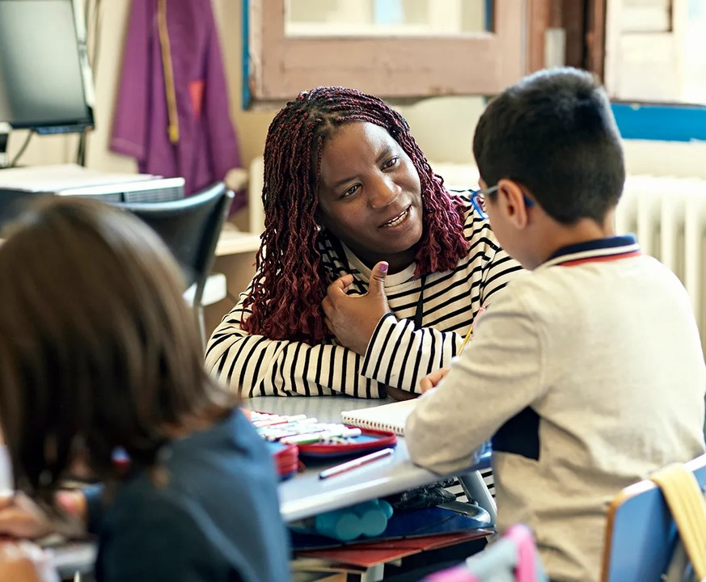
2. Encourage
Persistence and effort, rather than just praising or evaluating the work the child has done.
“You’re thinking of lots of words to describe the dog in the story. Let’s keep going!”

Slide 26
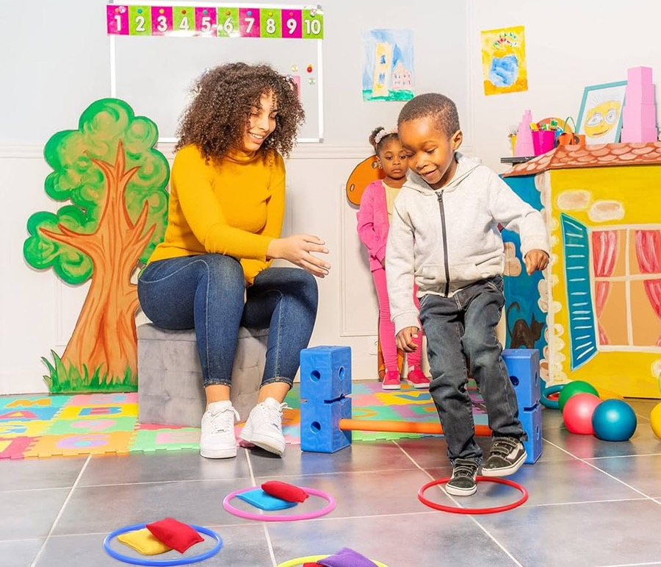
3. Give Specific Feedback
Rather than just general comments or praise.
“Your beanbag didn’t make it all the way to the hoop. Try throwing harder next time.”

Slide 27

4. Model
Attitudes, expectations, ways of approaching problems, behaviors towards others. Show children rather than telling them.
“I’m sorry ben, I didn’t hear your idea. Can you repeat it again please?”

Slide 28
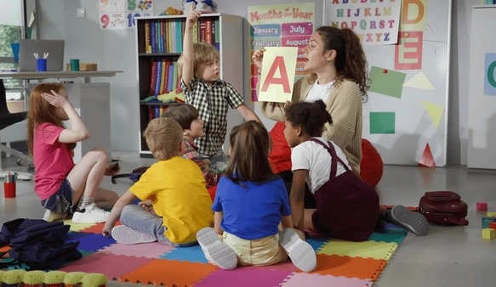
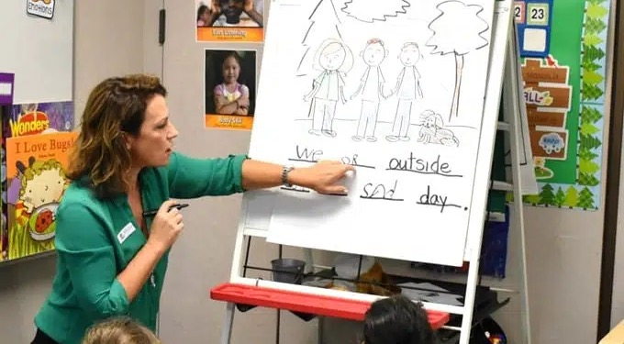
5. Demonstrate
The correct way to do something. This usually involves a procedure or specific steps or tasks that need to be accomplished in a certain way.
For example, demonstrate how to write the letter a by writing it several ways: on a chart, on the whiteboard, in the sand, and in the air. In shared writing, demonstrating that we read and write from left to right.

Slide 29
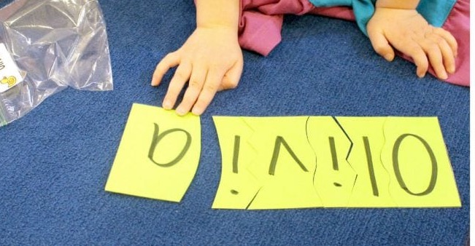
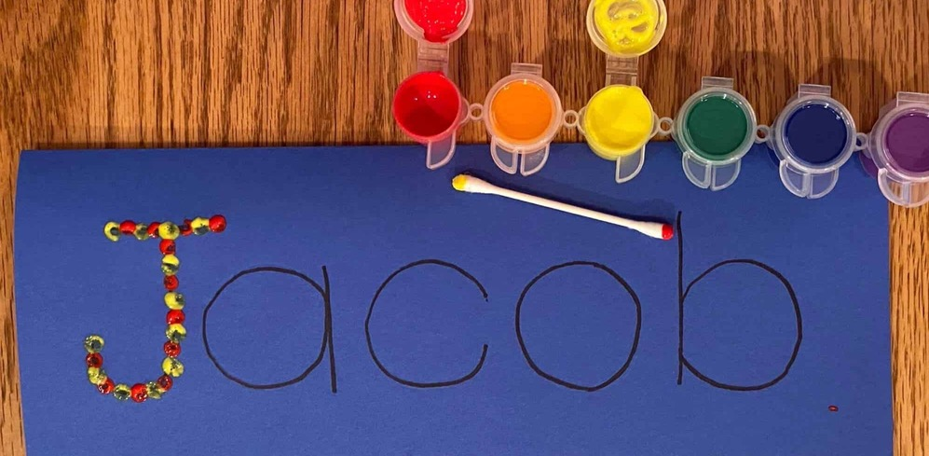
6. Create or Add Challenge
So that a task goes a bit beyond what they can already do. Work within their “Zone of Proximal Development.”
For example, after children can visually identify their name, it’s time to have students identify the individual letters in their name, sequence the letters in their name, and to write the letters in their name.

Slide 30

7. Ask Questions
That engage children in language expansion and critical thinking skills.
Ask open-ended questions!
“Let’s make a prediction! By looking at the picture on the cover and reading the title, what do you think this story will be about?”

Slide 31

8. Give Assistance
Such as a clue or a hint, to help children work on the edge of their current competence.
Can you think of a word that rhymes with your name, Matt? Yes! Matt and bat!

Slide 32
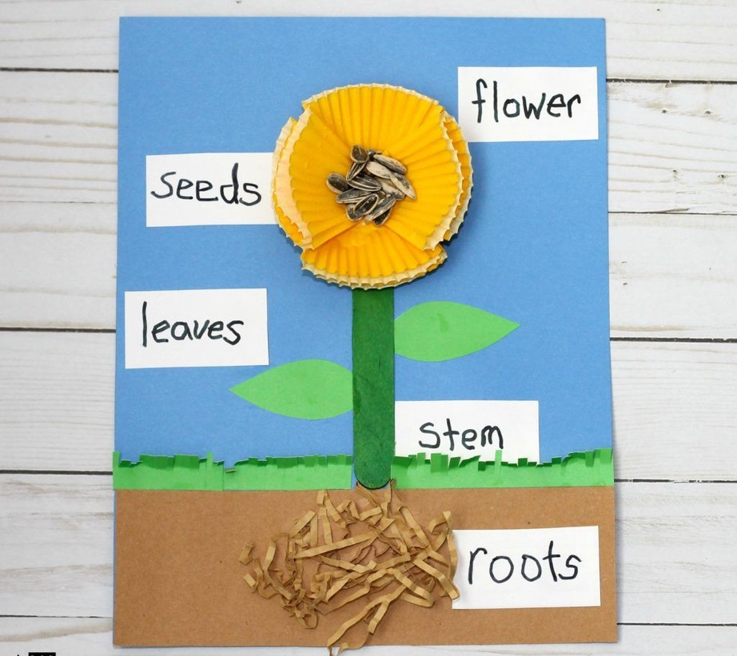
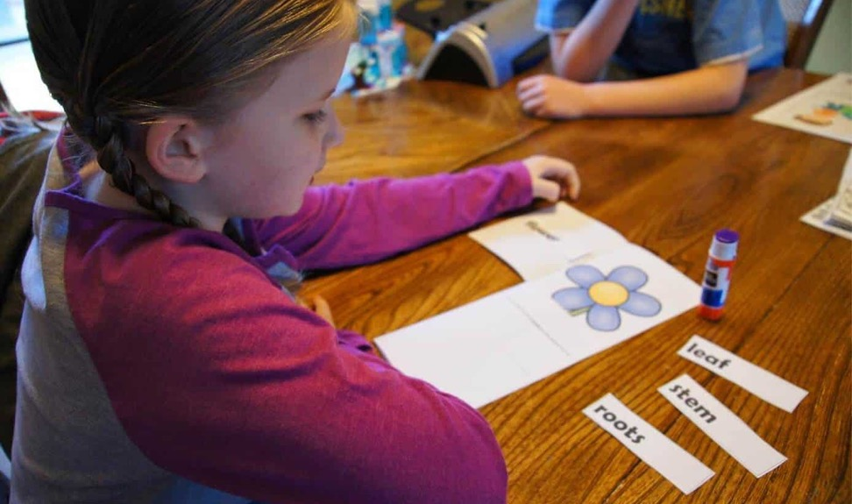
9. Provide Information
Directly, giving children facts, verbal labels, and other information.
“Let’s label the parts of the plant with the correct labels or names.”

Slide 33
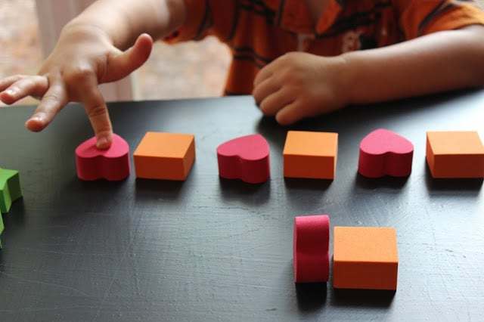

10. Give Directions
For children’s behavior and actions.
“Touch each block only once as you count each block.”

Slide 34


Teaching Young Children (1 of 2):
P–3 educators have a professional responsibility to be life-long learners who are able to foster life-long learning in children; in this, they must keep abreast of research developments, while also learning continuously from families and communities they serve.

Slide 35

Teaching Young Children (2 of 2):
With their knowledge, skill, and training, teachers—in collaboration with families—can ensure that programs promote and enhance every child’s learning.

Slide 36

DAP Alignment in P–3 (1 of 3)
Successful P–3 alignment requires cross-sector work, joint administrator and teacher professional learning opportunities, aligned instructional tools and learning environments, data-driven decision-making, engaged families, and continuity of pathways.

Slide 37

DAP Alignment in P–3 (2 of 3)
Research has shown that PreK–3 alignment—coordinating PreK–3 standards, curricula, instructional practices, assessments, and teacher professional development from PreK through the early elementary years—can be an effective means to grow student outcomes.
This kind of coordination is seen as a way to launch children on a positive developmental path, with early elementary grades continuing to build on what children learn in preschool.

Slide 38

DAP Alignment in P–3 (3 of 3)
A high-quality, developmentally appropriate curriculum that aligns state standards from pre-k through 3rd grade and supports the development of the whole child.

Slide 39
References
National Association for the Education of Young Children. (2020). Professional Standards and Competencies for Early Childhood Educators. Washington, DC: NAEYC. https://naeyc.org/resources/position
Basics of Developmentally Appropriate Practice: An Introduction for Teachers of Kindergartners. (2013). Philips, E. & Scrinzi, A. National Association for the Education of Young Children.
Neuman, S. B., & Dickinson, D. K. (Eds.). (2001). Handbook of early literacy research. Guilford Press
Saracho, O. N. (2004). Supporting literacy-related play: Roles for teachers of young children. Early Childhood Education Journal, 31(3), 201-206.
Parker, R., & Thomsen, B.S. (2019). Learning through play at school: A study of playful integrated pedagogies that foster children’s holistic skills development in the primary grades.
Early childhood education: The likelihood of sustained effects,” in The pre-K debates: Current controversies and issues, eds. E. Zigler, W. S. Gilliam, and W. S. Barnett (Baltimore: Paul H Brookes Publishing, 2011): 200-205.
Kauerz, K. & Coffman, J. (2019). Framework for Planning, Implementing, and Evaluating P–3 Approaches (2nd ed.). Denver, CO: National P–3 Center, School of Education and Human Development, University of Colorado Denver.
Hirsh-Pasek, K., Golinkoff, R. M., Nesbitt, K., Lautenbach, C., Blinkoff, E., & Fifer, G. (2022). Making schools work: Bringing the science of learning to joyful classroom practice. New York: Teachers College Press.

